Slide 1
Weekly Carfilzomib, Cyclophosphamide and Dexamethasone (wCCd) in Newly Diagnosed Multiple Myeloma Patients: A Phase I-II Study
Abstract 175
Palumbo A, Rossi D, Bringhen S, Larocca A, Gentilini F, De Paoli L, Omedé P, Ballanti S, Cavallo F, Passera R, Liberati AM, Boccadoro M, Gaidano G, Sonneveld P, Corradini P

Slide 2

Rationale
 | Bortezomib Twice Weekly | Bortezomib Once Weekly | P value
CR | 35% | 30% | .27
PR | 32% | 30% | .66
PFS @ 3 years | 47% | 50% | 1.00
OS @ 3 years | 89% | 88% | .54
Hematologic AEs | 45% | 44% | .83
Nonhematologic AEs | 51% | 35% | .003
PNP | 28% | 8% | <.001
Gastrointestinal AEs | 11% | 6% | .08
Median dose intensity | 59% | 84% | <.001
Median delivered dose – mg/m² | 39.4 | 40.1
Dose reduction | 41% | 17% | <.001
Discontinuation | 15% | 5% | <.001
CR, complete response; PR, partial response; PFS, progression-free survival; OS, overall survival; AE, adverse event; PNP, peripheral neuropathy
Bringhen S, et al. Blood. 2010;116(23):4745-4753.
Palumbo A, et al. Blood. 2014;124: Abstract 175.

Slide 3
Key Objectives
Primary:
Phase I: maximum tolerated dose (MTD) of weekly carfilzomib
Phase II: response rate
Secondary:
Safety
Progression-free survival (PFS)
Time to progression (TTP)
Duration of response (DOR)
Time to next therapy (TTNT)
Outcome in subgroups with different prognosis according to: β2-microglobulin, C-reactive protein (CRP), FISH, gene expression profile
PFS and OS of maintenance
Palumbo A, et al. Blood. 2014;124: Abstract 175.

Slide 4
Patient Eligibility
Key inclusion criteria:
Symptomatic newly diagnosed MM
≥65-years-of-age or ineligible for autologous stem cell transplantation
Measurable disease ( ≥0.5 g/dL of M-protein or urine light-chain excretion of >200 mg/24 hours)
ECOG 0-2
Adequate hepatic function (ALT ≤3.5 times the upper limit of normal and serum direct bilirubin ≤2 mg/dL)
Creatinine clearance (CrCl) ≥15 mL/min
Key exclusion criteria:
Prior systemic MM therapy
Relapsed or refractory MM
History of severe heart disease
Uncontrolled hypertension or congestive heart failure (CHF)
Palumbo A, et al. Blood. 2014;124: Abstract 175.

Slide 5
Study Design
Phase I/II - Multicenter (8 centers)
wCCyd Induction
C Maintenance
Cycles 1-9
Until progression
Response Assessments
Cycle day
1 8 15 22
1 8 15 22
1 8 15 22
1 8 15 22
1 8 15 22
1 8 15 22
Carfilzomib
Dose (mg/m²)
CYCLE 1
CYCLE 2
CYCLE 3
CYCLE 5
CYCLE 1
CYCLE 2
CYCLE 9
MAINTENANCE
Cyphosphamide
300 mg/m² orally
Cohort | Carfilzomib* mg/m² | Cyclo mg/m² | Dex** mg
1 | 45 | 300 | 40
2 | 56 | 300 | 40
3 | 70 | 300 | 40
Dexamethasone
40 mg orally
*All patients received 20 mg/m² carfilzomib on D1 of cycle 1; subsequent doses were escalated to the indicated levels
**or 20 mg of dexamethasone on days 1,2,8,9,15,16,22,23.
wCCyd, weekly carfilzomib-cyclophosphamide-dexamethasone; C maintenance, carfilzomib maintenance.
Palumbo A, et al. Blood. 2014;124: Abstract 175.

Slide 6
Enrollment
From April 2013 to data cutoff (September 2014), 30 patients have been enrolled
Phase I (April 2013 and October 2013)
12 patients
Carfilzomib dose cohorts:
MTD: 70 mg/m²
Phase II
Stage I (November 2013 – June 2014): 16 patients
Stage II (July 2014 – ongoing): 2 patients
21 patients treated at the MTD
3 from dose escalation, 18 from phase II
 | 45 mg/m² | 56 mg/m² | 70 mg/m²
No. of patients | 3 | 6 | 3
DLT | 0 | 1 | 0
Type of DLT | - | Creatinine increase | -
Palumbo A, et al. Blood. 2014;124: Abstract 175.
DLT, dose-limiting toxicity; MTD, maximum tolerated dose.

Slide 7
Patient Characteristics
 | Phase I, n = 12 | Phase II, n = 18 | Total, N = 30
Median age, years (range) | 73 (65–79) | 74 (64–79) | 74 (64–79)
Age ≥75 years, n (%) | 4 (33) | 5 (28) | 9 (30)
Male, n (%) | 5 (42) | 8 (44) | 13 (43)
ISS stage at diagnosis, n (%)
I | 4 (33) | 8 (44) | 12 (40)
II | 4 (33) | 3 (17) | 7 (23)
III | 4 (33) | 7 (39) | 11 (37)
Unfavorable profile*, n (%) | 3/9 (40) | 4/12 (33) | 7/21 (33)
del 17 | 3 (33) | 4 (33) | 7 (33)
t(4;14) | 0 | 0 | 0
t(14;16) | 1 (11) | 0 | 1 (5)
Creatinine clearance, n (%)
>60 mL/min | 7 (58) | 14 (78) | 21 (70)
30-60 mL/min | 4 (33) | 3 (17) | 7 (23)
<30 mL/min | 1 (9) | 1 (5) | 2 (7)
*Unfavorable profile was assessed by FISH and included del 17, t(4;14) or t(14;16). ISS, International Staging System
Palumbo A, et al. Blood. 2014;124: Abstract 175.

Slide 8
Treatment Exposure
 | Phase I, n = 12 | MTD, n = 21 | Total, N = 30
Median cycles of wCCyd received, n (range) | 9 (1–9) | 4 (1–9) | 8 (1–9)
Patients treated with … cycles of CCyd, n (%)
≥4 | 11 (92) | 11 (52) | 23 (77)
≥8 | 10 (83) | 7 (33) | 15 (50)
Patients started maintenance, n (%) | 9 (75) | 3 (14) | 10 (33)
Median relative dose intensity*, %
Carfilzomib | 100 | 100 | 100
Cyclophosphamide | 100 | 100 | 100
Dexamethasone | 85 | 92 | 96
Patients remaining on treatment,† n (%) | 8 (67) | 17 (81) | 24 (80)
Reasons for going off treatment, n (%)
Adverse events | 2 (17) | 2 (9) | 3 (10)
Progressive disease | 1 (8) | 1 (5) | 2 (7)
Other | 1 (8) | 1 (5) | 2 (7)
*Dose taken/dose prescribed. †At data cut-off of September 30, 2014.
wCCyd, weekly carfilzomib-cyclophosphamide-dexamethasone
Palumbo A, et al. Blood. 2014;124: Abstract 175.

Slide 9
Summary of Safety Profile
AE, n (%) | Phase I N = 12 | MTD N = 21 | Total N = 30
Any serious AE* (SAE) | 1 (8) | 4 (19) | 5 (17)
Any drug-related SAE† | 1 (8) | 4 (19) | 4 (13)
Dose reduction due to AE | 3 (25) | 0 | 3 (10)
On-study death | 0 | 1 (5) | 1 (3)
AE, adverse event. *AEs graded using NCI-CTCAE v4.02. †Drug-related defined as related to any drug in the combination
Palumbo A, et al. Blood. 2014;124: Abstract 175.

Slide 10
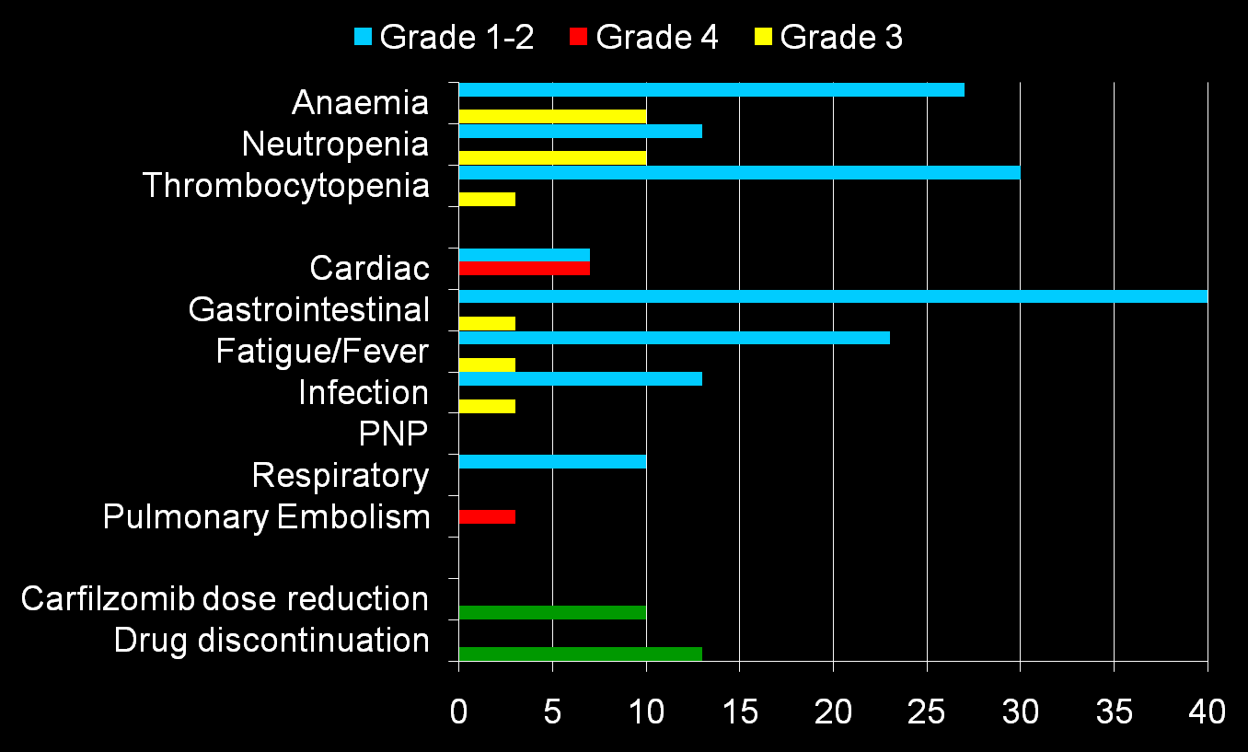
Adverse Events – All Grades, All Patients
Percentage of Patients
Palumbo A, et al. Blood. 2014;124: Abstract 175.
PNP, peripheral neuropathy

Slide 11

Adverse Events – Grade 3-4 Weekly vs Twice Weekly
Percentage of Patients
Palumbo A, et al. Blood. 2014;124: Abstract 175.
PNP, peripheral neuropathy; VTE, venous thromboembolism

Slide 12
Preliminary Response Data
28 of 30 patients were evaluable for response (2 patients not evaluable for response due to early discontinuation [pulmonary edema] and 1st cycle ongoing)
Median time to first response (≥PR) was 1 month
Median duration of response not reached
 | Phase I n = 12 | MTD n = 19 | Total N = 28
Median cycles received, n (range) | 9 (1–9) | 4 (1–9) | 8 (1–9)
ORR (≥PR), n (%) | 11 (92) | 15 (79) | 24 (86)
≥VGPR, n (%) | 9 (75) | 11 (58) | 18 (64)
sCR + CR + nCR, n (%) | 4 (33) | 4 (21) | 7(25)
PR, partial response; ORR, overall response rate; VGPR, very good partial response; CR, complete response; sCR, stringent complete response; nCR, near complete response; MTD, maximum tolerated dose.
Palumbo A, et al. Blood. 2014;124: Abstract 175.

Slide 13
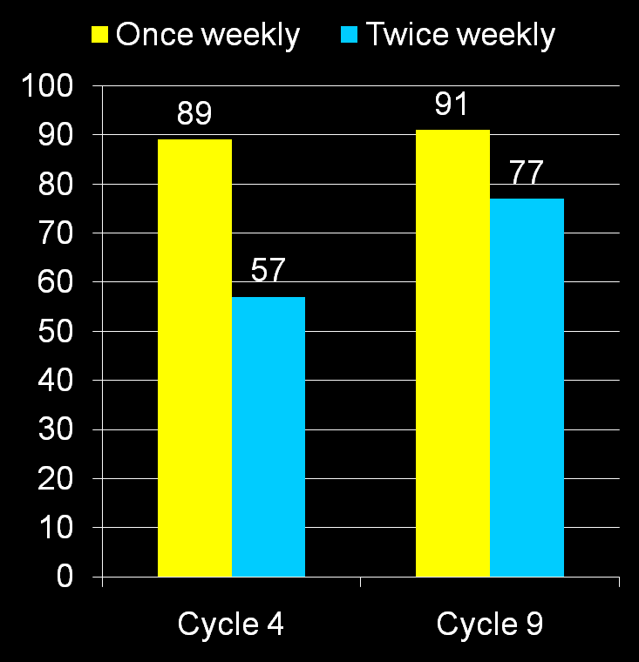
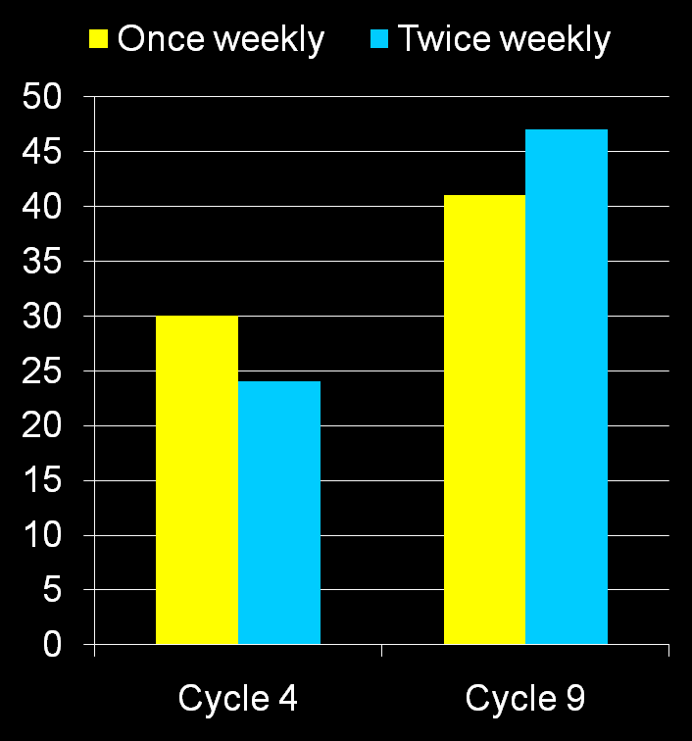
Response Rate By Treatment Duration
Weekly vs Twice Weekly
At Least nCR
At Least VGPR
47
41
30
24
% of Patients
Palumbo A, et al. Blood. 2014;124: Abstract 175.
nCR, near complete response; VGPR, very good partial response.

Slide 14
Conclusions
 | CCyd once weekly | CCyd twice weekly
> nCR* | 41% | 47%
PR* | 99% | 91%
Grade 3-4 hematologic | 23% | 27%
Grade 3-4 nonhematologic | 30% | 29%
Median delivered carfilzomib dose, mg* | 3534 | 2904
Dose reduction | 10% | 21%
Discontinuation | 13% | 14%
* After 9 cycles of Ccyd
CCyd, carfilzomib-cyclophosphamide-dexamethasone; PR, partial response; nCR, near complete response; PFS, progression-free survival.
Palumbo A, et al. Blood. 2014;124: Abstract 175.

